Slide 1


Azure Database for MySQL and Maria DB
Speaker name or subtitle text

Slide 2
Technology changes faster than ever
IoT devices
Cloud computing
Search engines
Cell phones
Internet
Operating systems
Word processor
Microprocessor
Moon landing
Radio
Car
Telephone
Light bulb
Telegraph
Steam engine
Telescope
Printing press
1400
1500
1600
1700
1800
1900
2000
Notes:
The pace of technology advances is accelerating at an unprecedented rate. Breakthrough innovations are causing the volume of data to explode (data from sensors, social media, apps and data found across the enterprise within documents, excel files, for example).
The scale and economics of cloud computing make it possible to capture and harness data, creating new and exceptional opportunities for people and organizations to innovate, grow faster, and achieve more than ever before.
Organizations have the chance to fundamentally redefine the way they engage customers, transform products, optimize operations and engage employees.

Slide 3
Economic stability impacted by disruptive events
COVID-19 pandemic
Black Thursday
Black Monday
Brexit decision
US-China economic conflict
European debt crisis
Greek debt crisis
Great Recession
SARS outbreak
Dot-com bubble
Sept 11 attacks (US)
Early 1990s recession
Savings & loan crisis (US)
Black Monday
Early 1980s recession
Energy crisis
US economic recession
The Great Depression
World War II
World War I
1900s
1920s
1940s
1960s
1980s
2000s
2020s
Notes:
But, as economies become more interdependent, large-scale events can introduce volatility and uncertainty to global markets. Over time, the frequency of these events has accelerated.
How businesses respond in times of uncertainty is as varied as the businesses themselves. Many will slow down operations to operate more cost-effectively, while others may lean into new opportunities that may not have otherwise existed. Across this entire spectrum, the ability to cost-effectively adapt and scale to rapidly changing conditions and manage the underlying risk is paramount.

Slide 4
Manage risk and meet the pace of change in the cloud
20.6% average improvement in time to market¹
Companies that adopt cloud services experience:
19.6% average increase in company growth¹
18.8% average increase in process efficiency¹
94%
of all workloads will be run in the cloud by 2021²
1. Vanson Bourne. “The Business Impact of the Cloud” report
2. Cisco Global Cloud Index (2016-2021)
Notes:
The same need to cost-effectively adapt and scale applies to digital transformation, too, as organizations make decisions to either pause, slow down or accelerate their journeys to the cloud.
Companies that embrace the pace of change and manage the risk by adopting cloud services can see substantial improvements in time-to-market, growth and overall efficiency.

Slide 5
Be future-ready with Azure and open source
Leverage your favorite open source services on Azure with:
Seamless migration of Linux workloads
Support for modern development practices including Azure Kubernetes Service
Choice of fully managed open source database including MySQL, PostgreSQL and MariaDB
Compatibility with latest open source extensions and tools
Enjoy community-driven quality with a large developer network
A.I.
Intelligent by default
Scale
Limitless
Hybrid
Operational freedom
Azure
OSS
Security
Always a step ahead
90% of enterprises deploy open source in some form
Notes:
Microsoft Azure is the cloud that lets you turn ideas into solutions with more than 100 services to build, deploy, and manage applications—in the cloud, on-premises, and at the edge—using the tools and frameworks of your choice. Our track record of continuous innovation supports your development today and your visions for tomorrow. Over the past year, we’ve launched over 1000 capabilities on the platform, helping our customers be future-ready. The cloud is moving fast – every week a new technology is coming out. So it’s about meeting new capabilities now and investing in those on the horizon.
In the world of data, we are committed to empowering organizations to build on their terms with flexibility and choice, and that includes the freedom to operate anywhere.
Nothing is more important than trust, particularly when you’re talking about the cloud. We spend $1B a year on cyber security with 3500 cyber security engineers who are constantly monitoring your data for threats. We’ve invested ahead of the curve in layers of security with built-in controls to protect your data and close the gaps that attackers can exploit. Trust your workloads to Azure, built upon the most secure cloud with the broadest compliance coverage.
Break through the resource constraints of modern application development with limitless scale that goes far beyond other cloud providers.
Modernize existing apps or build new apps on Azure with built-in, AI-based technologies that power new customer experiences.
Azure can help you innovate today, tomorrow, and in the future. We are constantly providing capabilities that can help meet your needs.

Slide 6





Azure managed databases include popular open source engines
Azure SQL Database
Azure SQL Managed Instance
Azure Database for PostgreSQL
Azure Database for MySQL
Azure Database for MariaDB
Azure Cache for Redis
Azure Cosmos DB
Managed, intelligent SQL in the cloud
Enterprise-ready, fully managed and scalable open-source databases
In-memory data store to power fast, scalable applications
Globally distributed, multi-model dataset service for any scale
Notes:
We have a rich portfolio of operational databases on Azure that are grounded in choice and flexibility. We want customers to have the right tool for every use case they encounter.
<Detailed descriptions of each database service for reference>
Azure SQL Database
Azure SQL Database is the intelligent, scalable, relational database service that supports modern cloud applications. It’s evergreen and always up to date, with AI-powered and automated features that optimize performance and durability for you. Serverless compute and Hyperscale storage options automatically scale resources on demand, so you can focus on building new applications without worrying about storage size or resource management.
Azure SQL Managed Instance
Azure SQL Managed Instance is the intelligent, scalable, cloud database service that combines the broadest SQL Server engine compatibility with all the benefits of a fully managed and evergreen platform as a service. Modernize your existing SQL Server applications at scale with SQL Managed Instance.
Azure Database for PostgreSQL is a relational database service based on the open-source Postgres database engine. It's a fully managed database as a service offering that can handle mission-critical workloads with predictable performance, security, high availability, and dynamic scalability
Azure Database for MySQL is a relational database service based on the open-source MySQL Server engine. It's a fully managed database as a service offering that can handle mission-critical workloads with predictable performance and dynamic scalability.
Azure Database for MariaDB is a relational database service in the Microsoft cloud. Azure Database for MariaDB is based on the MariaDB community edition (available under the GPLv2 license) database engine, version 10.2 and 10.3.
Azure Cosmos DB
Azure Cosmos DB is a globally distributed database service. It supports schema-less data that lets you build highly responsive and Always On applications to support constantly changing data. You can use this feature to store data that is updated and maintained by users around the world. The following illustration shows a sample Azure Cosmos DB database that's used to store data that's accessed by people located across the globe.

Slide 7




Open source developers are using MySQL and MariaDB databases
54% of devs build on MySQL, the most popular OS database
3x popularity growth of MariaDB in the last three years
Key reasons behind the popularity
OLTP
Community support and a rich ecosystem of tools
Lower TCO from fewer licensing fees
Low resource consumption through ongoing advancements
Optimized for OLTP websites
A key part of the LAMP stack
Notes:
https://insights.stackoverflow.com/survey/2019?utm_source=so-owned&utm_medium=blog&utm_campaign=dev-survey-2019&utm_content=launch-blog
http://www.oracle.com/us/products/mysql/mysql-wp-top10-webbased-apps-461054.pdf
https://db-engines.com/en/blog_post/77
MariaDB has nearly tripled its popularity over the last 3 years. - https://db-engines.com/en/blog_post/77
•Developers love OSS because they care about innovation and being in control of their work.
Innovation and control are critical compononets of how Microsoft supports in this space
•AWS and GCP focus on the value of their consoles whereas Azure focuses on improving the value of OSS communities.
•A developer is focused on one particular DB and will not be comparing across OSS Azure services. (def between post and My/Maria)
Language across OSS on Azure pages does not have to be perfectly parallel.
•MySQL is still thriving and popular, however die-hard community devs jumped ship to MariaDB.
MySQL to Azure developers prioritize popular use cases such as WordPress and Drupal, whereas MariaDB devs prioritize community and enhanced functionality (JSN).

Slide 8
Azure takes the admin out of MySQL and MariaDB
Intelligent Features |  |  | Intelligent security and performance features
Managed by Microsoft |  | Virtualization Hardware Datacenter management | High availability /DR/Backups Database provision/ Patch/Scaling O/S provision /patching Virtualization Hardware Datacenter management
Managed by customer | Applications Data High availability /DR/Backups Database provision/ Patch/Scaling O/S provision/patching Virtualization Hardware Datacenter management | Applications Data High availability /DR/Backups Database provision/ Patch/Scaling O/S provision | Applications Data
 | On-premises MySQL | IaaS Azure VMs with MySQL/ MariaDB | PaaS Azure Database for MySQL/ MariaDB
Azure Databases for MySQL and MariaDB are fully managed, enterprise-ready community databases-as-a-service to help you focus on your app, not your database
Protect data with greater manageability and security
Speed queries and insights with better performance and intelligence
Deploy apps globally in minutes
Save time with built-in tools and resources
Improve TCO with built-in features for HA, performance and security

Slide 9
Azure Databases for MySQL and MariaDB Brings Azure innovation to your favorite community database
Fully managed community database
Built-in high availability for lowest TCO
Intelligent performance and scale
Industry-leading security and compliance
Integration with the Azure ecosystem
Take advantage of a fully managed service with support for latest versions
Ensure your data is always available without the need for additional configuration or cost
Improve performance with built-in intelligence and up to 16TB storage and 20K IOPs
Protect your data with enhanced security features including Advanced Threat Protection
Build apps faster with Azure services and safeguard your innovation with Azure IP Advantage
Pay for only what you use and reduce TCO with built-in features for performance, HA and security

Slide 10
Azure Database for MySQL deployment options
Single Server
Flexible Server (Preview)^{NEW}
Fully-managed, MySQL database service with built-in HA
Example use cases
Cloud native applications designed to handle automated patching
Online web applications with minimal requirements for customizations of the database
Applications without zonal redundancy requirements
Maximum control for your database with a simplified developer experience
Example use cases
Application developments requiring more control and customizations
Mission-critical apps needing high availability and fine-grained maintenance scheduling
Applications requiring variable compute capacity to optimize costs

Slide 11
Lowest TCO with built-in high availability (1 of 2)
Take advantage of the global reach and enterprise-ready features of Azure to maintain business continuity at 50% cost savings compared to AWS RDS
Get high availability backed with 99.99% SLA guarantees without the need to create a replica, compared to AWS’ 99.95% HA with multi-availability zones
Optimize your infrastructure cost by right-sizing your instances based on workload demands
Reduce development and DBA costs associated with performance troubleshooting and alerting
High availability price comparison of Azure Database for MySQL and AWS RDS MySQL
50% savings vs. AWS
50% savings vs. AWS

Slide 12
Optimize costs and lower total cost of ownership No upfront cost. No termination fees. Pay only for what you use
Flexible pricing options
Scale compute, memory, and storage independently and pay only for what you use. Get everything you need including capabilities such as automatic database patching, query optimization, and security all at no extra cost.
Reserved Capacity
Choice of 1 year or 3 year Reserved Capacity pricing and save up to 60 percent compared to the regular pay-as-you-go payment options.
Stop/Start
Stop the MySQL server when its not needed for up to 7 days
Only pay for storage while the server is stopped
Burstable Compute SKUs
Utilize Burstable CPU credits for workloads that need extra performance during peak times
Notes:
Key offers lower your total cost of ownership
Azure Hybrid Benefit for SQL Server - Significantly reduces migration costs by using on-premises SQL licenses (with active Software Assurance) for discounted rates in the cloud.
Azure-only benefit provides up to 55% savings vs pay-as-you-go pricing, and up to 59% savings vs AWS
Available to customers with SQL Server licenses and active Software Assurance
Unique benefit for highly virtualized workloads, providing 4 vCores of SQL Database General Purpose in the cloud for every 1 on-premises core in SQL Enterprise Edition.
Reserved capacity pricing – Improve budget and forecasting by prepaying for 1 or 3-year terms with reserved capacity pricing.
Discounted rates up to 33% for 1- or 3-year term commitments
Combine with Azure Hybrid Benefit for up to 80% savings off license-included rates
Exchange or cancel reservations
Scale up or down within a tier with auto-fit
Dev/test pricing - Discounted rates up to 55% off license-included to support ongoing development and testing. Eligible with active Visual Studio subscription.

Slide 13
Maximum control and flexibility to meet your workload needs with flexible Server
Maximum control for your databases
Build resilient apps across availability zones
Simplified developer experience
Control planned downtime with custom maintenance windows
Network isolation with VNet integration and network security groups
Multiple configuration parameters for fine grained database optimization and tuning
Ensure data is always available with zone redundant high availability
Zero data loss within single and multiple availability zones
Guided developer experience increases productivity and simplifies end-to-end deployment
Full compatibility with community edition MySQL
Stop/Start and burstable capabilities for cost optimization

Slide 14





Optimize cost and ensure business continuity with Azure Databases for MySQL and MariaDB
Connect with customers online with a modern web experiences
Ensure sales continuity with reliable ecommerce platform
Provide a high-quality remote learning with learning management solutions (LMS)
Get to market quickly building modern apps on Azure Database for MySQL
Migrate your MySQL and MariaDB to Azure and reduce TCO
Easily build open source web apps using popular CMS (WordPress or Drupal) and enterprise packaged applications like Alfresco.
Develop ecommerce applications including popular packaged applications such as Magento or Shopify
Deliver online educational programs with Moodle and Azure Database for MySQL
Build new custom apps in the cloud with microservice architecture using Azure Kubernetes and Azure Database for MySQL or MariaDB
Seamless migration with benefit of reduced database administration. Get to market quicker and scale applications based on changing application requirements
Notes:
Intelligent apps
Develop sophisticated, transformational apps using state-of-the-art machine-learning algorithms and integrated visualization tools for analytics and actionable insights.
Retail and e-commerce
Build highly secure and scalable e-commerce solutions that meet the demands of both consumer and business customers. Engage customers through targeted products and offers, process transactions quickly, and optimize fulfillment and customer service.
Scalable web and mobile applications
Rapidly build engaging, scalable cross-platform and native apps for iOS, Android, Windows, or Mac.
Digital marketing
Engage with customers around the world with rich, personalized digital marketing experiences. Quickly build and launch digital campaigns that automatically scale based on traffic and customer demand.
Financial management apps
Securely store critical data and provide high-value analytics and insights over aggregated data to users, using built-in security and high availability.
Gaming
Scale your databases elastically to accommodate unpredictable bursts of traffic and deliver low-latency multi-player experiences.

Slide 15
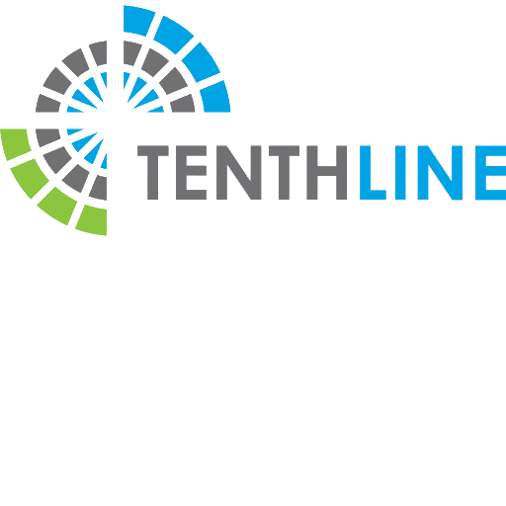
Build enterprise web apps using packaged apps like Alfresco
Alfresco deployment with cross-region read replicas
Accelerate time to market by leaving database management to Azure Database for MySQL
Integrate effortlessly with popular enterprise content management systems like Alfresco
Choose from many languages like PHP, Java, Node.js, and more
NAT gateway
Virtual private cloud
Region 1
Region 2 read replica
Azure Blob Storage
Alfresco servers
Alfresco content services
Auto scaling group
Alfresco servers
Alfresco search services
Auto scaling group
Index servers
Index servers
Tenthline secures a modern financial services infrastructure on open-source stack on Azure
Notes:
Remove the AWS Availability zones and update it for different regions for Cross region read replica (real use case of Tenthline)
NAT gateway remains
Amazon S3 changes to block blob
RDS instance to Azure DB for MySQL\
remove private IP subnet

Slide 16
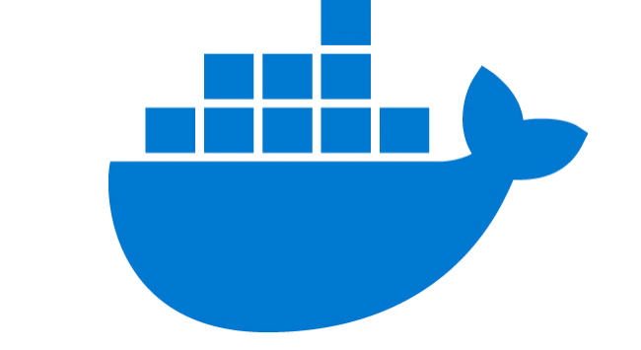
Build web apps with popular CMS including WordPress or Drupal
Accelerate time to market by leaving database management to Azure Database for MySQL
Run an Azure Database for MySQL server side-by-side Azure App Service to simplify development
Integrate effortlessly with popular content management systems like WordPress, Drupal, and Joomla
Choose from many languages like PHP, Java, Node.js, and more
Scalable open source architecture using Azure App Service environment
Azure Database for MySQL
v
Content Delivery Network
Azure App Service
Redis Cache
Monitoring/ Logging
Users
Docker Hub
Azure Database for MySQL provides a fully managed service to store vast content as part of the Nobel Prize’s WordPress site
Notes:
https://customers.microsoft.com/en-us/story/nobel-media-media-telecommunications-linux-on-ase

Slide 17
Ensure sales continuity with reliable ecommerce platform using Magento and Azure Database for MySQL
Provide a fast go-to-market experience for customers integrated with pre-existing app such as Magento
Ensure fault tolerant performance with built-in high availability while paying less
Complete transactions in 500 milliseconds with 20K IOPS and 16 TB of storage on Azure Database for MySQL
Leverage read-replicas to scale out read-only workloads for analytical platforms
Magento cloud architecture on Azure
AKS Kubernetes Cluster
NGINX 1.15.5 Ingress
Cache service (2 pod instances)
Varnish Pod
Varnish Pod
Redis-cache service
(1 pod instance)
Web (Magento) service
WEB Pod
Redis Cache (1)
App (Magento) service
Redis-session service
(1 pod instance)
APP Pod
Redis Cache (1)
Notes:
Complete transactions in 500 milliseconds with 20K IOPS and 16 TB of storage on Azure Database for MySQL

Slide 18






Provide a high-quality remote learning with popular LMS Moodle and Azure Database for MySQL
Empower educators to disseminate work efficiently by deployed Moodle on Azure with Azure Database for MySQL
Employ native MySQL tools, as Azure Database for MySQL is based on community version
Enable concurrent user access with Azure Database for MySQL
Use MySQL to store student scores, grades, and other student information
Save administrators time and resources with automated patching and backups
Moodle deployment architecture on Azure
Azure
VNet
User
IP
LB
Autoscaling VMSS web frontend
Gluster FS
Azure Database for MySQL
Admin (SSH)
IP
Controller VM
(w/ opt. NFS vol.)
Elastic VMS

Slide 19


Modern application built in the cloud with microservice architecture
Assess and enhance microservice performance with built-in query insights and recommendations
Quickly provision databases with microservices architectures and flexibly scale compute and storage independently without extra configuration
Easily integrate with Azure Kubernetes Service and other managed services to improve deployment and monitoring
Microservice architecture with Azure Database for MySQL and Azure Kubernetes Service
Azure Database for MySQL
Azure API Management
Azure Traffic Manager
Azure Kubernetes Service
Docker
Users
Azure Application Gateway
Azure Blob Storage
Danish IT company KMD can scale API services multiple times a day with Azure Database for MySQL and Azure Kubernetes Service

Slide 20


Modern mobile application enables streamlined and secure digital payments
Use Azure Database for MySQL in microservices architectures to store transactions and build a secure payment platform
Run ETL jobs every 15 minutes with read replicas for analytics
Enable high performance experiences for customers
Provide high uptime for transactions 24 hours a day with high levels of isolation with built-in high availability
Scale the compute and database layers based on service needs to manage costs
Digital payment platform architecture
Application platform
Analytical platform
Click stream
EventHub
Social timeline
To app
Azure APM
AKS
Cosmos DB
Azure Databricks
Azure MySQL
AKS
APP DBs
Azure MySQL
Events
Tableau
EventHub
Azure Storage
Insights generation
HSBC PayMe for Business app leverages Azure Database for MySQL for fast, secure, and simple payment transactions
Notes:
https://www.youtube.com/watch?v=KEYqG0IcUy8

Slide 21
Simplify migration and reduce administration with Azure
Free your team from database management by migrating on-premises and IaaS open source apps to Azure Database for MySQL or MariaDB
Choose the migration approach that best fits the needs of your workloads
Reduce downtime on large or critical databases with Azure Database Migration Service*
Use dump and restore or import/export for smaller databases that allow for downtime
Options for migrating to Azure Database Services
Discover and assess
DMS Continuous Sync
Azure Database Migration Service
Test
Connect to Azure with your favorite tool
Import/Export
Remediate apps
Dump and store
Optimize
Migrate schema and data
HSBC PayMe for Business app leverages Azure Database for MySQL for fast, secure, and simple payment transactions
*Azure Database Migration Service is only available on Azure Database for MySQL
Notes:
https://customers.microsoft.com/en-us/story/geekwire

Slide 22







Azure Database for MySQL helps customers around the world achieve more

Slide 23
Elevate MySQL with Azure
Azure Database for MySQL provides a fully managed community edition of MySQL with built-in high availability, automatic patching, predictable performance and enterprise grade security features.
Available in two deployment options for different use cases:
Single Server use cases
Cloud native applications designed to handle automated patching
Online web applications with minimal requirements for customizations of the database
Applications without zonal redundancy requirements
Flexible Server use cases ^{NEW}
Application developments requiring more control and customizations
Mission Critical apps utilizing zone redundancy and fine-grained maintenance scheduling
Applications requiring variable compute capacity to optimize costs
Fully managed community database
Built-in High Availability for lowest TCO
Intelligent performance and scale
Industry-leading security and compliance
Integration with the Azure ecosystem

Slide 24
Resources for migration
Microsoft Azure
Database Migration Guide http://aka.ms/datamigration
Azure Database Migration Service http://aka.ms/get-dms
Sign up for Preview http://aka.ms/dms-preview
Azure Database Migration Service
On-premises workloads
Notes:
Migration guide
Provides prescriptive guidance on how to do migrations. Customers have access to case studies of migrations that other customers already did. Customers will also find a list of partners that they can contact to get assistance to do migrations.
DMS
As organizations look to optimize their IT infrastructure to have more time and resources to focus on business transformation, Microsoft is committed to accelerating these initiatives. The new Azure Database Migration Service (DMS) is a fully managed, first party Azure service that enables seamless and frictionless migrations from heterogeneous database sources to Azure Database platforms with minimal downtime. This service will streamline the tasks required to move existing competitive and SQL Server databases to Azure.
Seamlessly migrate on-premise databases at scale
Experience near zero downtime for mission critical applications
Trust in a robust, resilient service for every migration scenario
Migrate multiple database sources to Azure
*Using DMS to migrate MySQL to Azure Database for MySQL will be at private preview during Azure Database for MySQL GA.
Migrate with minimum migrations
Uploading a large amount of data to the cloud takes some time. Customers cannot always tolerate to stop the application while the database is being migrated. Both DMS and Attunity Replicate For Microsoft Migrations allow customers to migrate with minimum application downtime. The way it works is: while the migration is happening, the data - that users change when using the application- is replicated to the target. The mount of application downtime that customers take is reduced to the time it takes them to points the application to the target (change the connection string, change the definition of the DMS alias…).

Slide 25
Call to action
Assess which workloads will benefit from Azure Database for MySQL and MariaDB
Connect with your Microsoft representative to learn more

Slide 26
Azure does more for MySQL and MariaDB
Fully managed community database
Built-in high availability for lowest TCO
Intelligent performance and scale
Industry-leading security and compliance
Integration with the Azure ecosystem

Slide 27
Documentation and resources
InfoPedia landing page: | http://aka.ms/ossdb (internal only)
OSS Database Migration Checklist:
MySQL homepage: | http://aka.ms/mysql
MariaDB homepage: | http://aka.ms/mariadb
MySQL documentation: | http://aka.ms/mysqldocs
MariaDB documentation: | https://aka.ms/mariadbdocs
Ask Questions: | AskAzureDBforMySQL@service.microsoft.com AskAzureDBforMariaDB@service.microsoft.com
MySQL Videos: | https://aka.ms/mysql-azure-videos
MariaDB Videos: | https://aka.ms/mariadb-azure-videos

Slide 28
Appendix

Slide 29
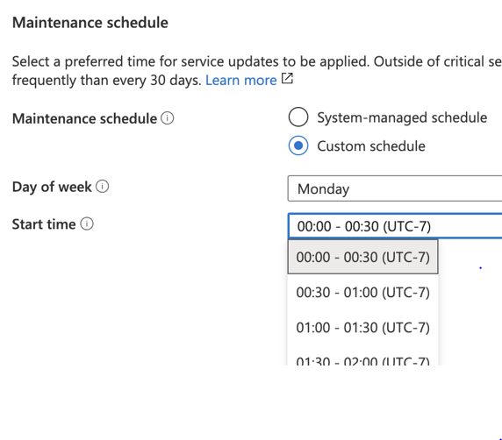
Custom Maintenance Windows
Choose maintenance window per server
Short duration downtime for planned maintenance
30 days (or more) between successful scheduled maintenance events
Notifications about scheduled maintenance 5 days in advance
Choice of
System-managed schedule: Maintenance between 11pm and 7am region time on system-selected day of week
Custom schedule: You select day of week and time window within day of week
Notes:
We update minor PostgreSQL version as a part of scheduled maintenance
If you need to preview updates before they’re applied to your production servers
Create your dev/test servers in Azure pilot region – West Central US – coming soon
Set custom schedule on your production servers and leave system-managed schedule on your dev/test servers to have your dev/test servers first

Slide 30
Zone redundant high availability
A synchronous standby replica in a different availability zone (AZ)
High data resiliency with physically separate synchronous copy of data
In the event of an unplanned downtime, automatic failover to standby
Zero data loss after a failover
Region-1
Primary
(AZ-1)
Standby
(AZ-2)
Notes:
We update minor PostgreSQL version as a part of scheduled maintenance
If you need to preview updates before they’re applied to your production servers
Create your dev/test servers in Azure pilot region – West Central US – coming soon
Set custom schedule on your production servers and leave system-managed schedule on your dev/test servers to have your dev/test servers first

Slide 31
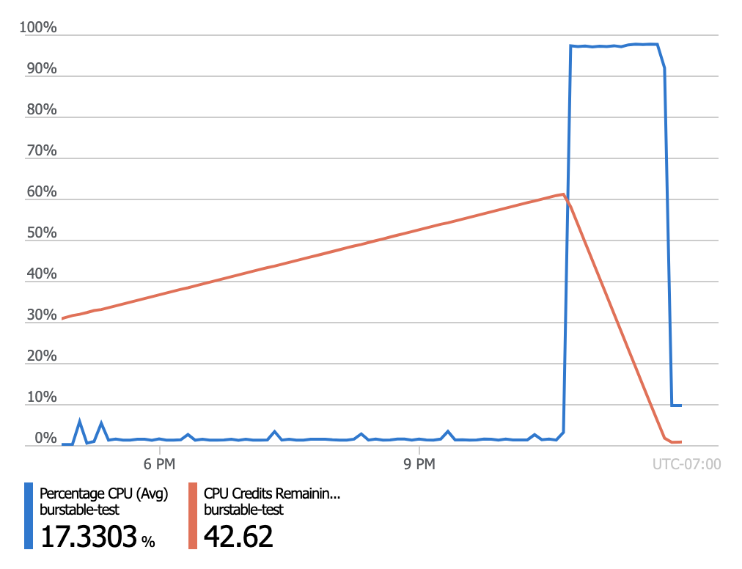
Simple cost optimization
Stop the MySQL server when its not needed for up to 7 days
Only pay for storage while the server is stopped
Utilize Burstable CPU credits for workloads that need extra performance during peak times
Notes:
We update minor PostgreSQL version as a part of scheduled maintenance
If you need to preview updates before they’re applied to your production servers
Create your dev/test servers in Azure pilot region – West Central US – coming soon
Set custom schedule on your production servers and leave system-managed schedule on your dev/test servers to have your dev/test servers first

Slide 32
Use your community database as a fully managed service
MySQL community versions 5.6 and 5.7
MariaDB community version 10.2 and 10.3
Infrastructure and database management, including feature updates, handled by Azure
Familiar tools and frameworks including WordPress, Drupal and Magento
Support for popular languages and drivers, such as PHP, Java and .NET
Guaranteed SLA of 99.99% connectivity

Slide 33
Lowest TCO with built-in high availability (2 of 2)
High availability price comparison of Azure Database for MySQL and AWS RDS MySQL
Take advantage of the global reach and enterprise-ready features of Azure to maintain business continuity at 50% cost savings compared to AWS RDS
Get high availability backed with 99.99% SLA guarantees without the need to create a replica, compared to AWS’ 99.95% HA with multi-availability zones
Optimize your infrastructure cost by right-sizing your instances based on workload demands
Reduce development and DBA costs associated with performance troubleshooting and alerting
50% savings vs. AWS
50% savings vs. AWS

Slide 34
Scale elastically and retain performance
Ensure increased performance with 16TB storage and 20K IOPs
Bring your data closer to your customer with more global cloud regions than any other provider
Elastically scale infrastructure when greater capacity is needed

Slide 35
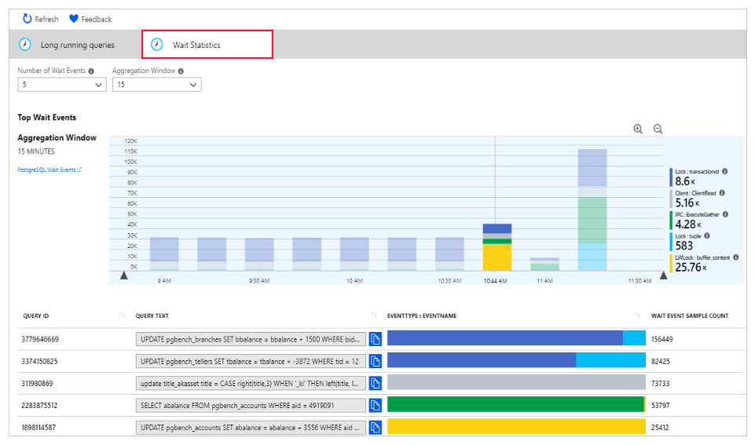
Optimize database performance with built-in intelligence
Uncovering long query times with Query Store
Query times
Query Store simplifies performance troubleshooting by helping you find the longest running and most resource-intensive queries
Query Performance Insights visualizes information to help you identify how your longest running queries change over time
Performance Recommendations analyzes your database to create customized suggestions for improved performance
Time
Wait Statistics in Query Performance Insights

Slide 36



Build safely on a cloud that offers advanced security and compliance
SOC 2
Type 2
Built-in security features like SSL, server firewall rules, VNET, and AAD integration
Data encrypted in motion and at rest
Advanced Threat Protection for automatic alerts on suspicious activities
The most comprehensive set of compliance offerings, including SOC, ISO, and HIPAA
Notes:
SOC2 - Service Organization Controls standards for operational security
ISO 27001 - Information Security Management Standards
ISO 27018 - Code of Practice for Protecting Personal Data in the Cloud
CSA STAR - Cloud Security Alliance: Security, Trust & Assurance Registry (STAR)
PCI DSS Level 1 - Payment Card Industry (PCI) Data Security Standard (DSS) Level 1 Service Provider
HIPAA / HITECH Act - Health Insurance Portability and Accountability Act / Health Information Technology for Economic and Clinical Health Act
ISO 27017:2015 - Code of Practice for Information Security Controls
ISO 9001:2015 Quality Management Systems Standards
ISO 22301:2012 Business Continuity Management Standard
ISO/IEC 20000-1:2011 Information Technology Service Management

Slide 37
Simplify app development through integration with the Azure ecosystem
Seamless integration with Azure services to extend functionality
Popular frameworks like WordPress and Drupal available in clicks with Azure App Services
Streamlined microservice management with Azure Kubernetes Service
Access to industry-leading capabilities like AI and analytics for smarter apps

Slide 38

Safeguard your innovation with Azure IP Advantage
Best-in-industry uncapped defense and indemnification coverage
Patent lawsuit protection through access to a portfolio of 10,000 patents that can be used to help counter assert against an aggressor

